Slide 1
Lab 7: Eigenvalues (Chapter 13)
BME 313L Introduction to Numerical Methods in Biomedical Engineering
2017 Spring

Slide 2
Polynomials
MATLAB has a built in program called roots to determine all the roots of a polynomial - including imaginary and complex ones.
x = roots(c)
x is a column vector containing the roots
c is a row vector containing the polynomial coefficients
Example:
– Find the roots of
f(x)=x⁵-3.5x⁴+2.75x³+2.125x²-3.875x+1.25
– x = roots([1 -3.5 2.75 2.125 -3.875 1.25])

Slide 3
Polynomials (cont)
MATLAB’s poly function can be used to determine polynomial coefficients if roots are given:
– b = poly([0.5 -1])
Finds f(x) where f(x) =0 for x=0.5 and x=-1
• MATLAB reports b = [1.000 0.5000 -0.5000]
This corresponds to f(x)=x²+0.5x-0.5
MATLAB’s polyval function can evaluate a polynomial at one or more points:
– a = [1 -3.5 2.75 2.125 -3.875 1.25];
If used as coefficients of a polynomial, this corresponds to
f(x)=x⁵-3.5x⁴+2.75x³+2.125x²-3.875x+1.25
– polyval(a, 1)
This calculates f(1), which MATLAB reports as -0.2500

Slide 4
Eigenvalues and Eigenvectors
What about a homogeneous system like this one:
(a₁₁ – λ) x₁ +
a₁₂ x₂ + a₁₃ x₃ = 0
a₂₁ x₁ + (a₂₂ – λ) x₂ +
a₂₃ x₃ = 0
ª31 ^{x}1 ⁺
or in matrix form
a₃₂ x₂ + (a₃₃ – λ) x₃ = 0
[[A] – λ [Ι ] ]{x} = 0
For this case, there could be a value of λ that makes the equations equal to zero (but x is non-trivial). This λ (a scalar) is called an eigenvalue. The associated {x} is called eigenvector.

Slide 5

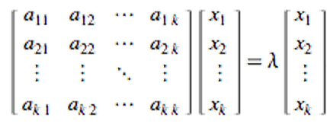
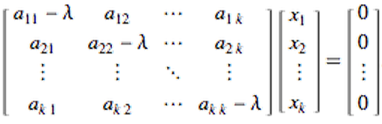

Basics of Eigenvalue Problem
Linear transformation A on vector X = constant * vector X
Matrix reorientation:
Rearrange:
or
What is the condition for the existence of nontrivial solution?

Slide 6
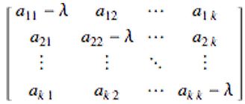
Det( )=0
K values of λ (eigenvalue) can be obtained
Q: What is significance of eigenvalue problems?
A: Many problem can be reduced to eigenvalue problem and gain insight into physical problem

Slide 7
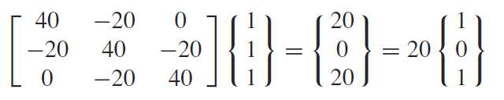
Example 13.4 Eigenvalues and Eigenvectors with MATLAB
>> A = [40 -20 0;-20 40 -20;0 -20 40];
>> e = eig(A)
Eigenvalues
>> [v,d] = eig(A)
Eigenvalues
Eigenvectors

Slide 8
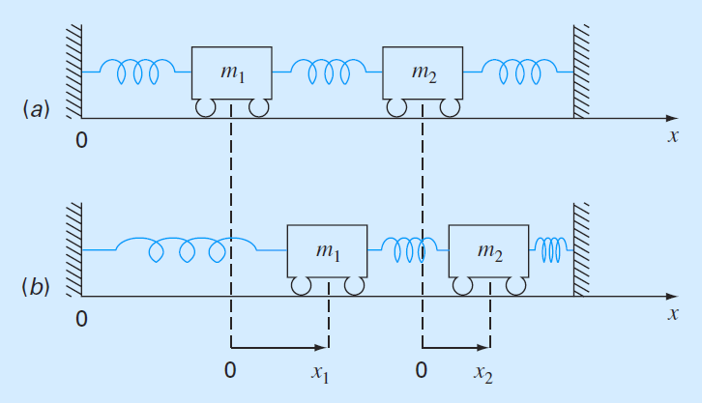


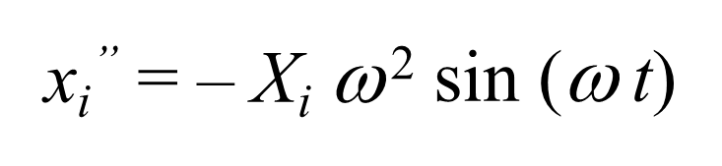

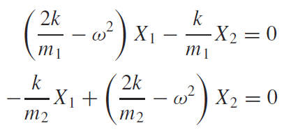
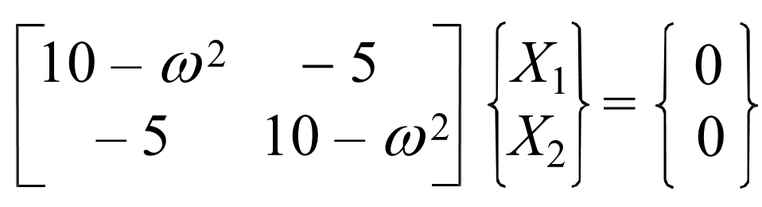
Example
m₁=m₂=40
K=200

Slide 9

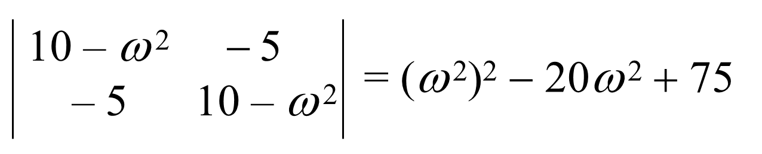
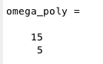
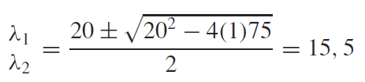
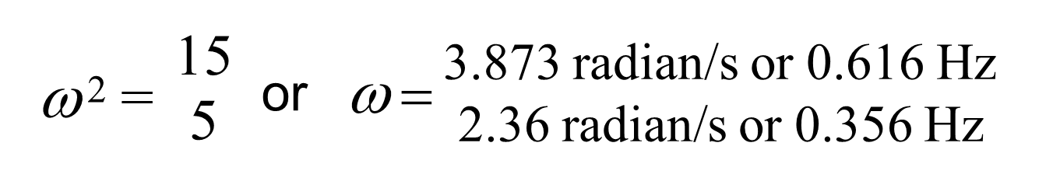

Polynomial Method
$$ω^{2}$$

Slide 10

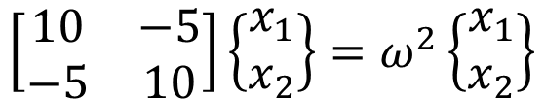
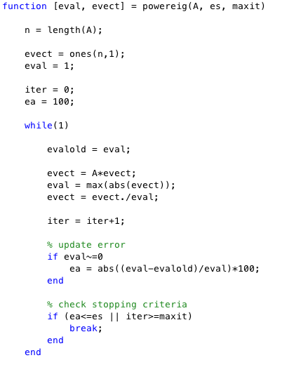
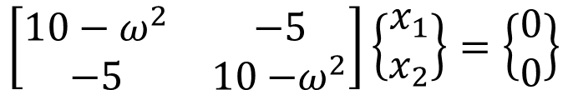
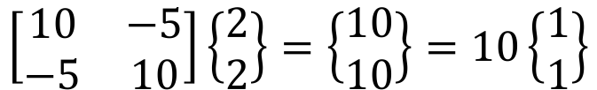
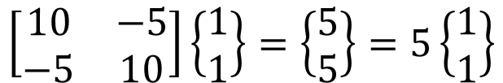
The Power Method
$$\left[\begin{matrix}10−ω^{2} & −5 \\ −5 & 10{−ω}^{2}\end{matrix}\right]\left\{\begin{matrix}x_{1} \\ x_{2}\end{matrix}\right\}=\left\{\begin{matrix}0 \\ 0\end{matrix}\right\}$$
$$\left[\begin{matrix}10 & −5 \\ −5 & 10\end{matrix}\right]\left\{\begin{matrix}x_{1} \\ x_{2}\end{matrix}\right\}=ω^{2}\left\{\begin{matrix}x_{1} \\ x_{2}\end{matrix}\right\}$$
Initial guesses
$$\left[\begin{matrix}10 & −5 \\ −5 & 10\end{matrix}\right]\left\{\begin{matrix}2 \\ 2\end{matrix}\right\}=\left\{\begin{matrix}10 \\ 10\end{matrix}\right\}=10\left\{\begin{matrix}1 \\ 1\end{matrix}\right\}$$
$$\left[\begin{matrix}10 & −5 \\ −5 & 10\end{matrix}\right]\left\{\begin{matrix}1 \\ 1\end{matrix}\right\}=\left\{\begin{matrix}5 \\ 5\end{matrix}\right\}=5\left\{\begin{matrix}1 \\ 1\end{matrix}\right\}$$
Eigenvectors
Eigenvalues

Slide 11
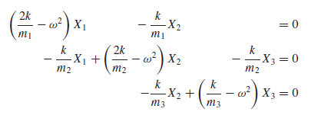
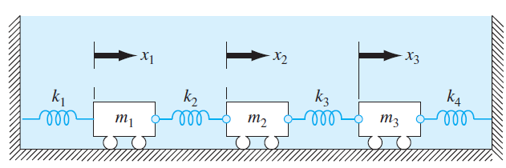
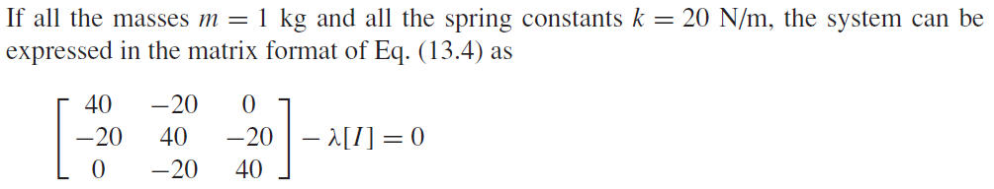

Power Method: example 13.3
A three mass-four spring system between two fixed walls:

Slide 12
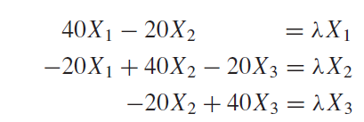
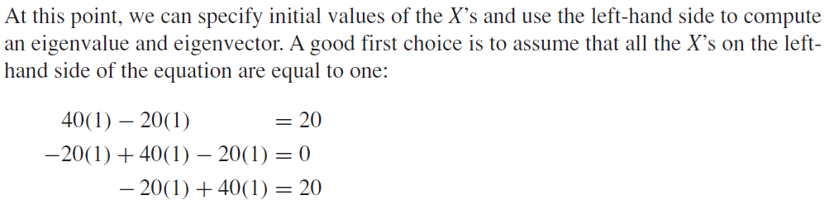
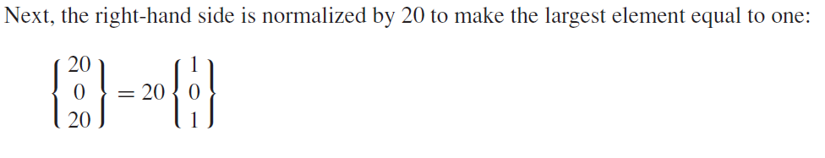

Slide 13
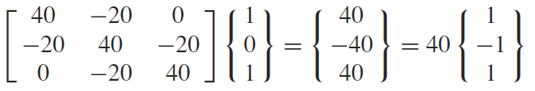
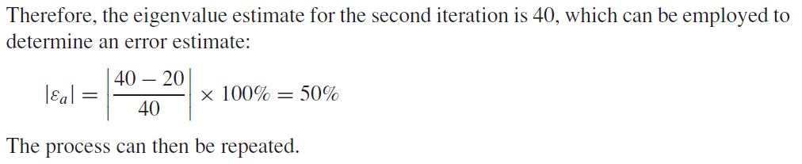
Initial guess of eigenvector
First iteration
Calculated eigenvalue
Calculated eigenvector
Use in the next iteration
Second iteration
New eigenvalue
New eigenvector

Slide 14
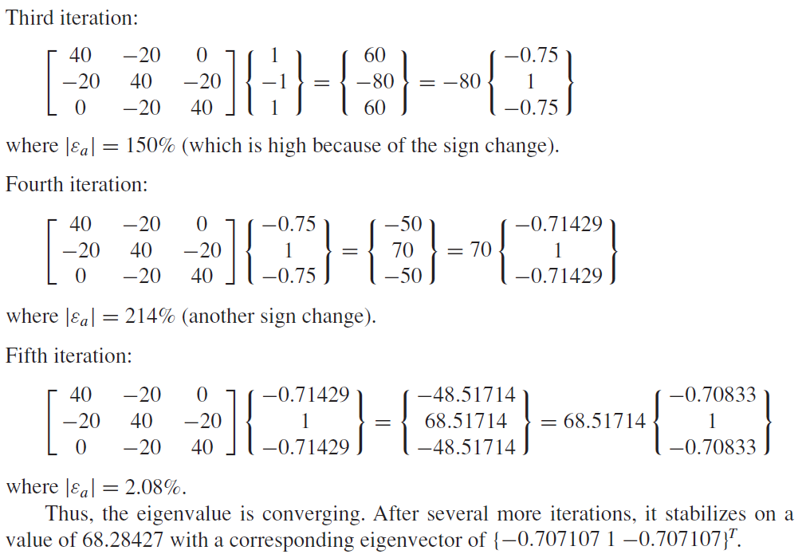
largest eigenvalue

Slide 15

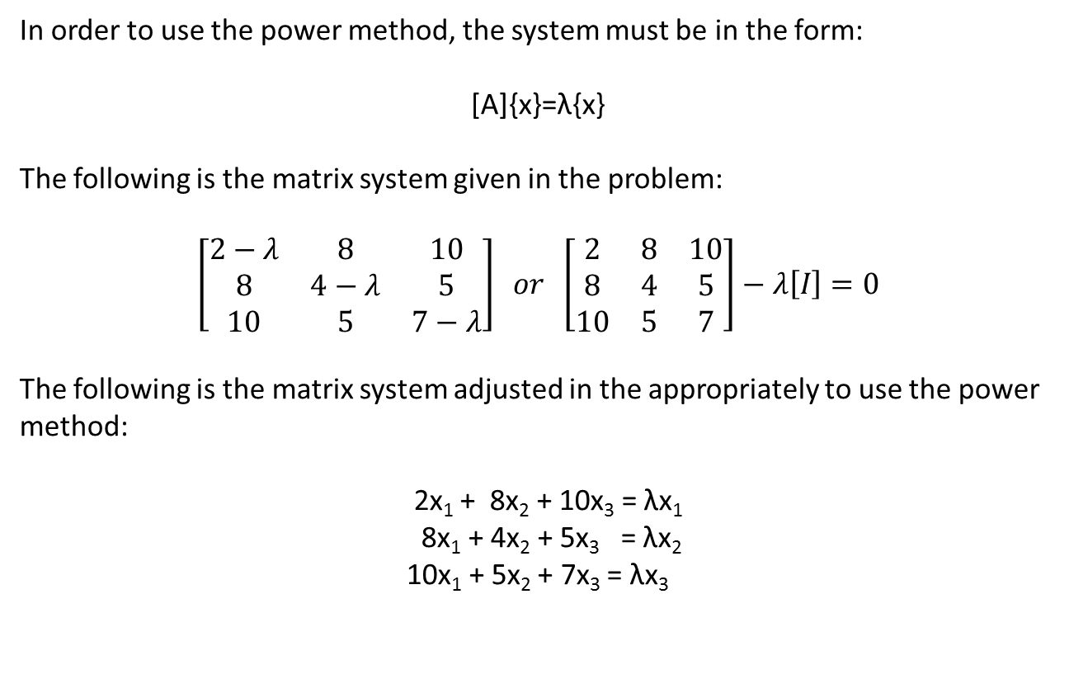
In order to use the power method, the system must be in the form:
[A]{x}=λ{x}
The following is the matrix system given in the problem:
$$\left[\begin{matrix}2−λ & 8 & 10 \\ 8 & 4−λ & 5 \\ 10 & 5 & 7−λ\end{matrix}\right] or \left[\begin{matrix}2 & 8 & 10 \\ 8 & 4 & 5 \\ 10 & 5 & 7\end{matrix}\right]−λ\left[I\right]=0$$
The following is the matrix system adjusted in the appropriately to use the power method:
2x₁ + 8x₂ + 10x₃ = λx₁
8x₁ + 4x₂ + 5x₃ = λx₂
10x₁ + 5x₂ + 7x₃ = λx₃

Slide 16
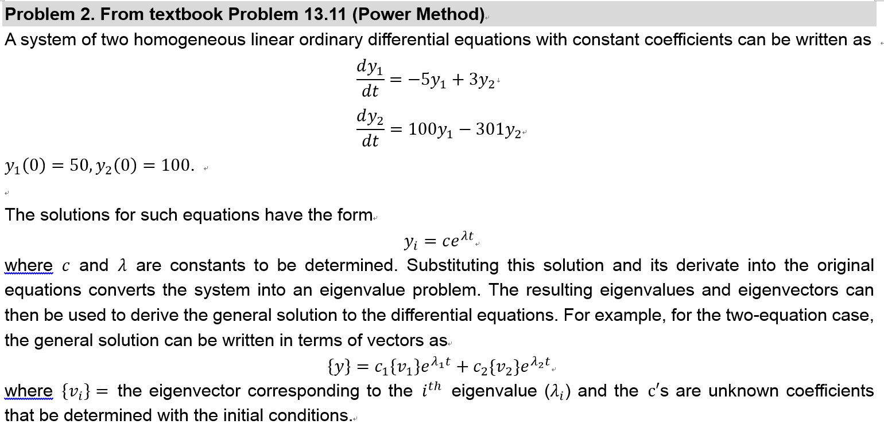
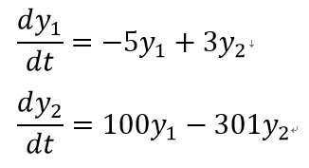

Step 1.
Step 2.
Plug eigenvalues and eigenvectors into
Step 3.
Find eigenvalues λ₁ and λ₂, eigenvectors ν₁ and ν₂.
Solve c₁ and c₂ with initial conditions

Slide 17












Step 1
$$\frac{dy_{1}}{dt}=−5y_{1}+3y_{2}$$
$$\frac{dy_{1}}{dt}=100y_{1}−301y_{2}$$
Step 2 Get the first derivatives
$$\frac{dy_{1}}{dt}=λc_{1}e^{λt}=λy_{1}$$
$${y_{i}=c}_{i}e^{λt}$$
$$\frac{dy_{2}}{dt}=λc_{2}e^{λt}=λy_{2}$$
Step 3 Substitute $\frac{dy}{dt}$
$$\frac{dy_{1}}{dt}=λy_{1}=−5y_{1}+3y_{2}$$
$$\frac{dy_{2}}{dt}=λy_{2}=100y_{1}−301y_{2}$$
Step 4 Rearrangement
$$−5y_{1}+3y_{2}=λy_{1}$$
$$\left(−5−λ\right)y_{1}+3y_{2}=0$$
$$100y_{1}−301y_{2}=λy_{2}$$
$$100y_{1}+\left(−301−λ\right)y_{2}=0$$
[A]{x}=λ{x}
([A]-λ [I]){x}=0

Slide 18
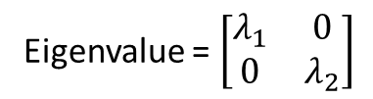




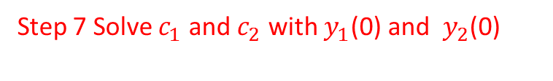


Step 5 Get eigenvalues and eigenvectors
[eigenvector, eigenvalue] = eig (A)
v1= $\left[\begin{matrix}E_{11} \\ E_{21}\end{matrix}\right]$ is corresponded to $λ_{1}$
Eigenvector = $\left[\begin{matrix}E_{11} & E_{12} \\ E_{21} & E_{22}\end{matrix}\right]$
v2= $\left[\begin{matrix}E_{12} \\ E_{22}\end{matrix}\right]$ is corresponded to $2$
V1
V2
Eigenvalue = $\left[\begin{matrix}λ_{1} & 0 \\ 0 & λ_{2}\end{matrix}\right]$
Step 6 Plug eigenvectors and eigenvalues in to the general solution
$$\left\{y\right\}=c_{1}\left\{v_{1}\right\}e^{λ_{1}t}{+c}_{2}\left\{v_{2}\right\}e^{λ_{2}t}$$
$$\left\{\begin{matrix}y_{1} \\ y_{2}\end{matrix}\right\}=c_{1}\left\{\begin{matrix}E_{11} \\ E_{21}\end{matrix}\right\}e^{λ_{1}t}{+c}_{2}\left\{\begin{matrix}E_{12} \\ E_{22}\end{matrix}\right\}e^{λ_{2}t}$$
Step 7 Solve $c_{1}$ and $c_{2}$ with $y_{1}$(0) and $y_{2}$(0)
$$\left\{\begin{matrix}50 \\ 100\end{matrix}\right\}=c_{1}\left\{\begin{matrix}E_{11} \\ E_{21}\end{matrix}\right\}{+c}_{2}\left\{\begin{matrix}E_{12} \\ E_{22}\end{matrix}\right\}$$

Slide 19
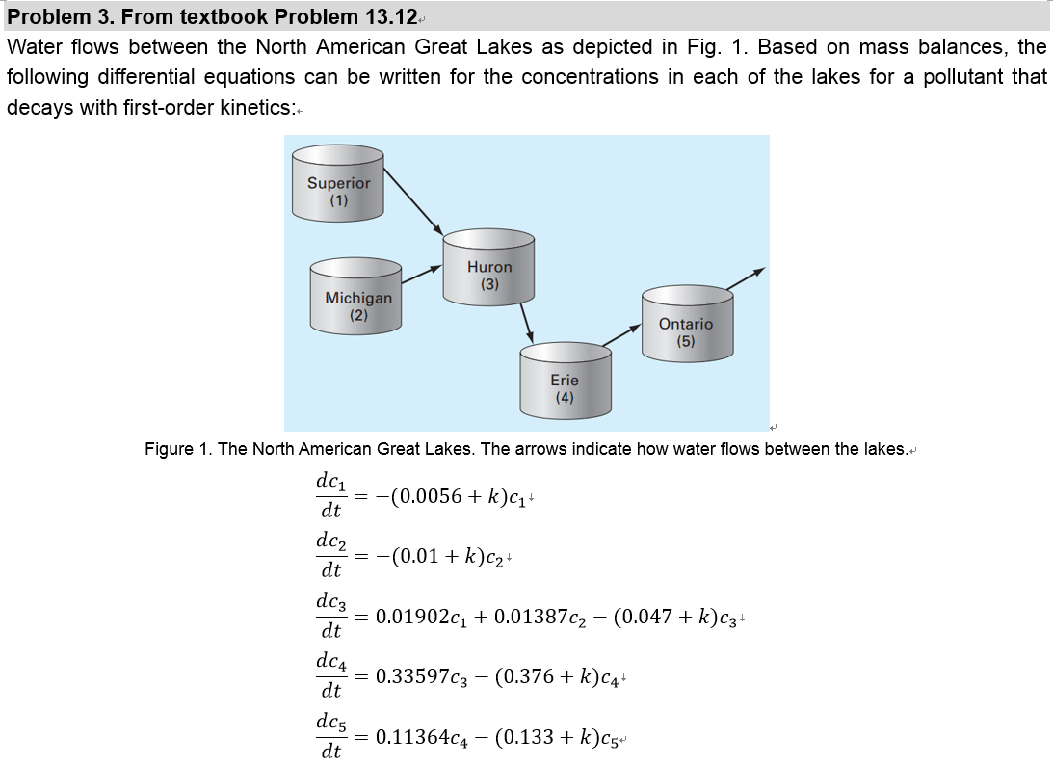
Use similar approach in problem 2.

